Slide 1


Adrian Brasser
March 2022

Slide 2

Outline
Executive Summary
Introduction
Methodology
Results
Conclusion
Appendix

Slide 3
Executive Summary
Summary of methodologies
Data collection
Data wrangling
EDA with data visualization
EDA with SQL
Building an interactive map with Folium
Building a Dashboard with Plotly Dash
Predictive analysis (Classification)
Summary of all results
Exploratory data analysis results
Interactive analytics demo in screenshots
Predictive analysis results

Slide 4
Introduction
Project background and context
The goal is to predict if the SpaceX Falcon 9 first stage will land successfully. The outcome of the landing of the first stage significantly influences the estimated cost of the delivery of goods into space. This prediction is valuable for our company SpaceY to set a competing price of our services in an auction against SpaceX
Problems you want to find answers
What influences if the rocket will land successfully?
The effect each relationship with certain rocket variables will impact in determining the success rate of a successful landing.
What conditions does SpaceX have to achieve to get the best results and ensure the best rocket success landing rate.

Slide 5

Section 1

Slide 6
Methodology
Data collection methodology:
Use SpaceX Rest API
Web Scrapping from Wikipedia
Perform data wrangling (Transforming data for Machine Learning)
One Hot Encoding data fields for Machine Learning and dropping irrelevant columns
Perform exploratory data analysis (EDA) using visualization and SQL
Plotting: Scatter plots, bar charts to show relationships between variables to show patterns of data
Perform interactive visual analytics using Folium and Plotly Dash
Perform predictive analysis using classification models
How to build, tune, evaluate classification models

Slide 7
Data Collection
We worked with SpaceX launch data that is gathered from the SpaceX REST API.
This API will give us data about launches, including information about the rocket used,
payload delivered, launch specifications, landing specifications, and landing outcome.
Our goal is to use this data to predict whether SpaceX will attempt to land a rocket or not.
The SpaceX REST API endpoints, or URL, starts with api.spacexdata.com/v4/.
Another popular data source for obtaining Falcon 9 Launch data is web scraping Wikipedia using BeautifulSoup.
SpaceX API
Web Scraping
1
Use SpaceX REST API
2
API returns SpaceX data in .JSON
3
Normalize data into flat data structure like a pandas dataframe
1
Get HTML Response from Wikipedia
2
Extract data using beatiful soup or pandas
3
Normalize data into flat data structure like a pandas dataframe

Slide 8
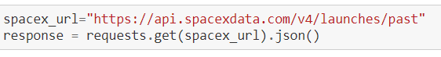
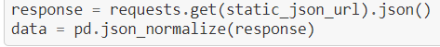
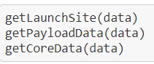
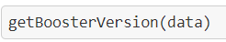
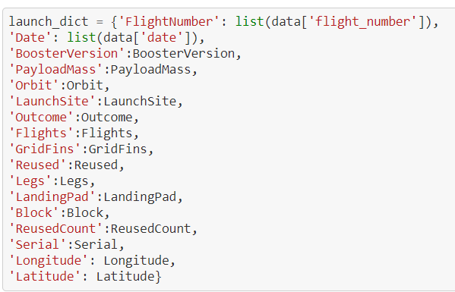
Data Collection – SpaceX API
1 .Get Response from API
2. Convert Response to a .json file
3. Apply custom functions to clean data
4. Assign list to dictionary then dataframe
5. Filter dataframe and export to flat file (.csv)
GitHub URL: Link
1
2
3
4
5

Slide 9
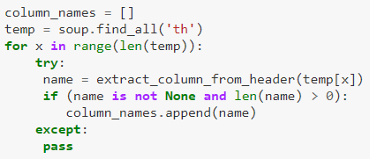
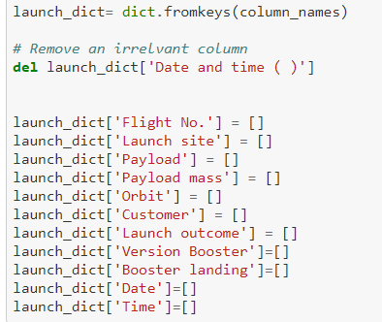
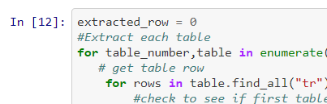
Data Collection - Scraping
1.Get Response from HTML
2. Create BeautifulSoup Object
3. Find tables
4. Get column names
5. Create of dictionary
6. Append data to keys
7. Convert dictionary to dataframe
8. Dataframe to .csv
GitHub URL: Link
1
2
3
5
4
6
7
8

Slide 10
Data Wrangling
Load data into dataframe
Check for missing values and clean it
Check data types and see if they make sense
Overview the data using value_counts
Classify outcomes success, failure into 0 and 1 for later use in model
GitHub URL to notebook: Link

Slide 11
EDA with Data Visualization
Visualize data using:
Catplots
Using for example (scatterplots using y="LaunchSite", x="FlightNumber", hue="Class“)
Barplots
Sucess Rate vs. Orbit
Lineplots
Success Rate vs. Year
GitHub URL to notebook: Link

Slide 12
EDA with SQL
Many different questions where asked about the data we needed information. We used SQL to query the data to solve the questions below.
Display the names of the unique launch sites in the space mission
Display 5 records where launch sites begin with the string 'KSC’
Display the total payload mass carried by boosters launched by NASA (CRS)
Display average payload mass carried by booster version F9 v1.1
List the date where the successful landing outcome in drone ship was achieved.
List the names of the boosters which have success in ground pad and have payload mass greater than 4000 but less than 6000
List the total number of successful and failure mission outcomes
List the names of the booster_versions which have carried the maximum payload mass.
List the records which will display the month names, successful landing_outcomes in ground pad ,booster versions, launch_site for the months in year 2017
Rank the count of successful landing_outcomes between the date 2010 06 04 and 2017 03 20 in descending order.
GitHub URL to notebook: Link

Slide 13
Build an Interactive Map with Folium
To visualize the Launch Data into an interactive map we took the coordinates (Latitude and Longitude) of each launch site and added a Circle Marker with a label displaying the name of the launch site.
As we want to analyze the launch outcomes we added a red info sign for failures and a green one for successes.
Further interesting information was the distance of the launch site to water, railroads and nearby cities.
GitHub URL to notebook: Link

Slide 14
Build a Dashboard with Plotly Dash
The dashboard is built with plotly dash and can be published on a website.
The dashboard includes can be switched between showing all launch sites (LS) or a specific one
Donut:
All: Donut chart to show the distribution of successful launches by launch sites
Specific LS: Success Rate
Scatterplot
All: Show Correlation between Payload and success for all launch sites
Specific LS: Show Correlation between Payload and success for a specific LS
The individual launches can be filtered by payload mass. This is done with a slider.
GitHub URL to notebook: Link

Slide 15
Predictive Analysis (Classification)
BUILD MODEL
Load our dataset into NumPy and Pandas
Transform Data
Split our data into training and test data sets
Check how many test samples we have
Decide which type of machine learning algorithms we want to use
Set our parameters and algorithms to GridSearchCV
Fit our datasets into the GridSearchCVobjects and train our dataset.
EVALUATE MODEL
Check accuracy for each model
Tune hyperparameters for each type of algorithms
Plot Confusion Matrix
IMPROVE MODEL
Feature Engineering
Algorithm Tuning
FIND THE BEST PERFORMING CLASSIFICATION MODEL
The model with the best accuracy score wins the best performing model
In the notebook there is a dictionary of algorithms with scores at the bottom of the notebook.
GitHub URL to notebook: Link

Slide 16
Results
Exploratory data analysis results
Interactive analytics demo in screenshots
Predictive analysis results

Slide 17

Section 2

Slide 18
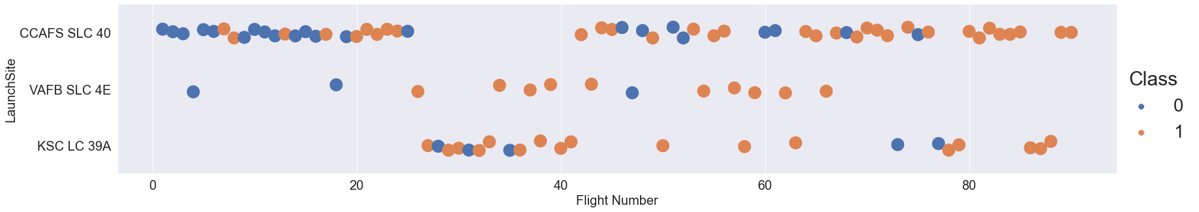
Flight Number vs. Launch Site
First launches were mostly failures while later launches were mostly successes.

Slide 19
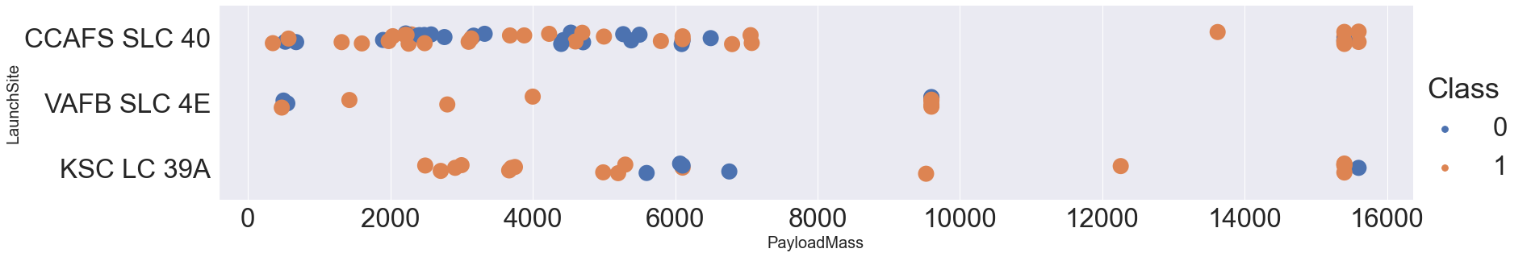
Payload vs. Launch Site
The higher the payload the lower the success probability (Class)

Slide 20
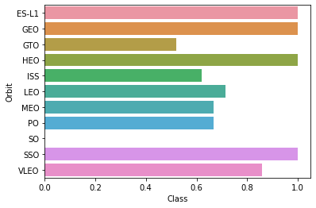
Success Rate vs. Orbit Type
ES-L1, GEO, HEO and SSO have perfect success rates.

Slide 21
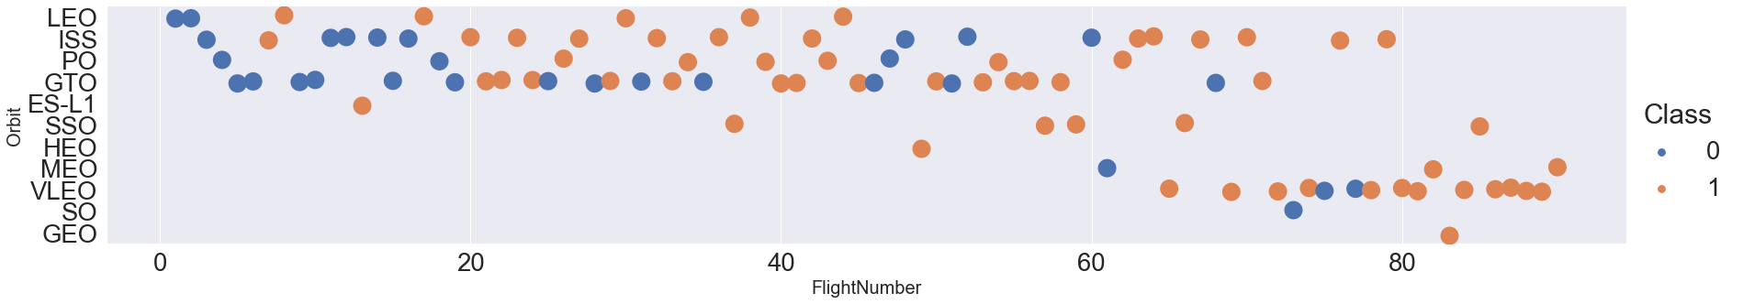
Flight Number vs. Orbit Type
First launches were mostly failures while later launches were mostly successes.
First Flights per Orbit where mostly failures.

Slide 22
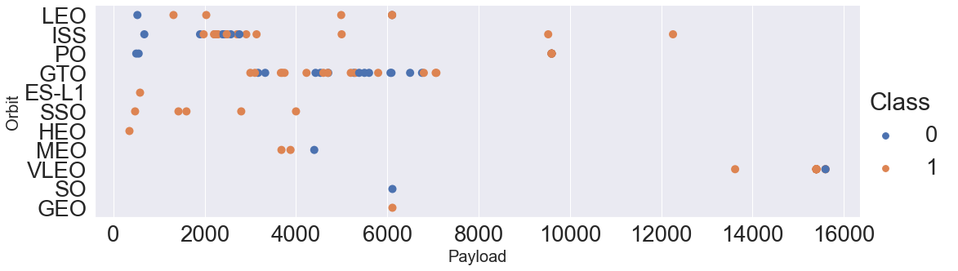
Payload vs. Orbit Type
The Payload is correlated to the orbit type.

Slide 23
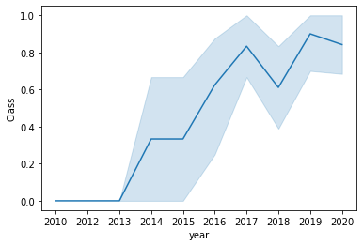
Launch Success Yearly Trend
The later the year the higher is the success rate (Class).

Slide 24
All Launch Site Names
SQL Query
Select unique(launch_site) from spacexdataset
Query Explanation
Using the word Unique in the query means that it will only show Unique values in the launch_site column from spacexdataset
Result
launch_site
CCAFS LC-40
CCAFS SLC-40
KSC LC-39A
VAFB SLC-4E

Slide 25
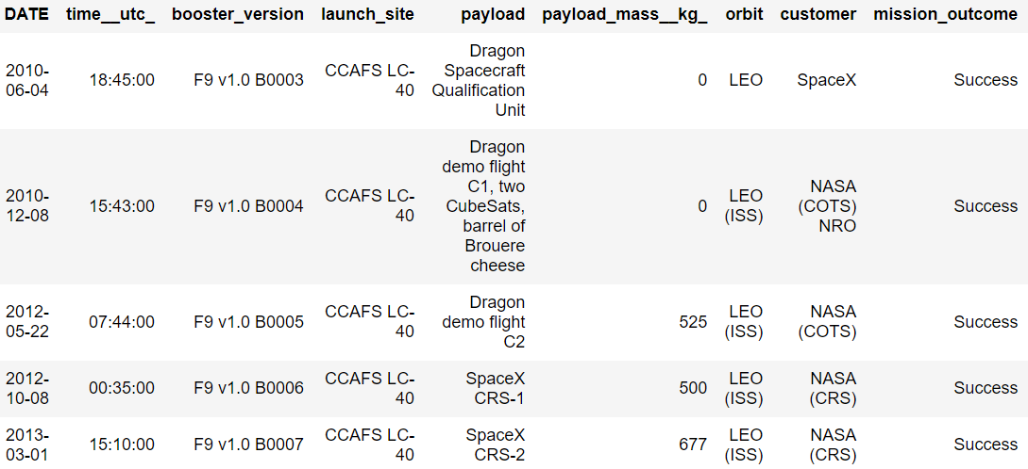
Launch Site Names Begin with 'CCA'
SQL Query
Select *
from spacexdataset
where launch_site Like 'CCA%'
limit 5
Query Explanation
Use Like and % to find names with wildcards
Limit the result set to 5 entries
Result

Slide 26
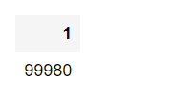
Total Payload Mass
SQL Query
select sum(payload_mass__kg_)
from spacexdataset
where customer like 'NASA%'
Query Explanation
Use Like and % to find names with wildcards
Sum the column
Result

Slide 27
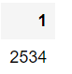
Average Payload Mass by F9 v1.1
SQL Query
select avg(payload_mass__kg_)
from spacexdataset
where booster_version like 'F9 v1.1%'
Query Explanation
Use Like and % to find names with wildcards
Average the column
Result

Slide 28
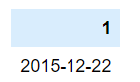
First Successful Ground Landing Date
SQL Query
select min(DATE)
from spacexdataset
where landing__outcome = 'Success (ground pad)'
Query Explanation
Take minimum of the column
Contrain with where
Result

Slide 29
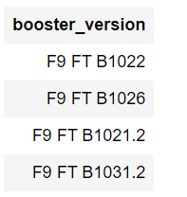
Successful Drone Ship Landing with Payload between 4000 and 6000
SQL Query
select booster_version
from spacexdataset
where landing__outcome = 'Success (drone ship)'
and (payload_mass__kg_ > 4000 and payload_mass__kg_ < 6000)
Query Explanation
Selecting only
Booster_Version
The
WHERE clause filters the dataset to Landing_Outcome =
Success (drone ship)
The
AND clause specifies additional filter conditions
Payload_MASS_KG
4000 AND Payload_MASS_KG 6000
Result

Slide 30
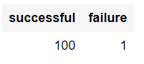
Total Number of Successful and Failure Mission Outcomes
SQL Query
Select
SUM(CASE when mission_outcome like 'Success%' THEN 1 ELSE 0 END) as successful,
SUM(CASE when mission_outcome like 'Fail%' THEN 1 ELSE 0 END) as failure
from spacexdataset
Query Explanation
Use CASE to assign 1 when success and 0 when not successful.
Sum it up
Result

Slide 31
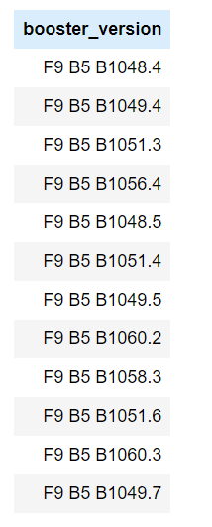
Boosters Carried Maximum Payload
SQL Query
Select booster_version
from spacexdataset
where payload_mass__kg_ = (Select max(payload_mass__kg_) from spacexdataset)
Query Explanation
Use Subquery to find the maximum payload first.
Then compare the payload mass from the table and return when it matches.
Result

Slide 32
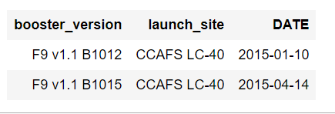
2015 Launch Records
SQL Query
select booster_version, launch_site, DATE
from spacexdataset
where landing__outcome = 'Failure (drone ship)'
and YEAR(DATE) = '2015'
Query Explanation
Get Year of the date column and compare if it is in the year 2015.
And if it is a failure
Result

Slide 33
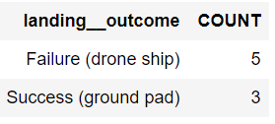
Rank Landing Outcomes Between 2010-06-04 and 2017-03-20
SQL Query
Select landing__outcome, Count(*) as Count
from spacexdataset
where (landing__outcome = 'Failure (drone ship)' or landing__outcome = 'Success (ground pad)')
and (Date > '2010-06-04' and Date < '2017-03-20')
group by landing__outcome
order by Count desc
Query Explanation
Group by landing outcome groups the occurences in that column.
Order by count orders by the count column.
Result

Slide 34

Section 3

Slide 35
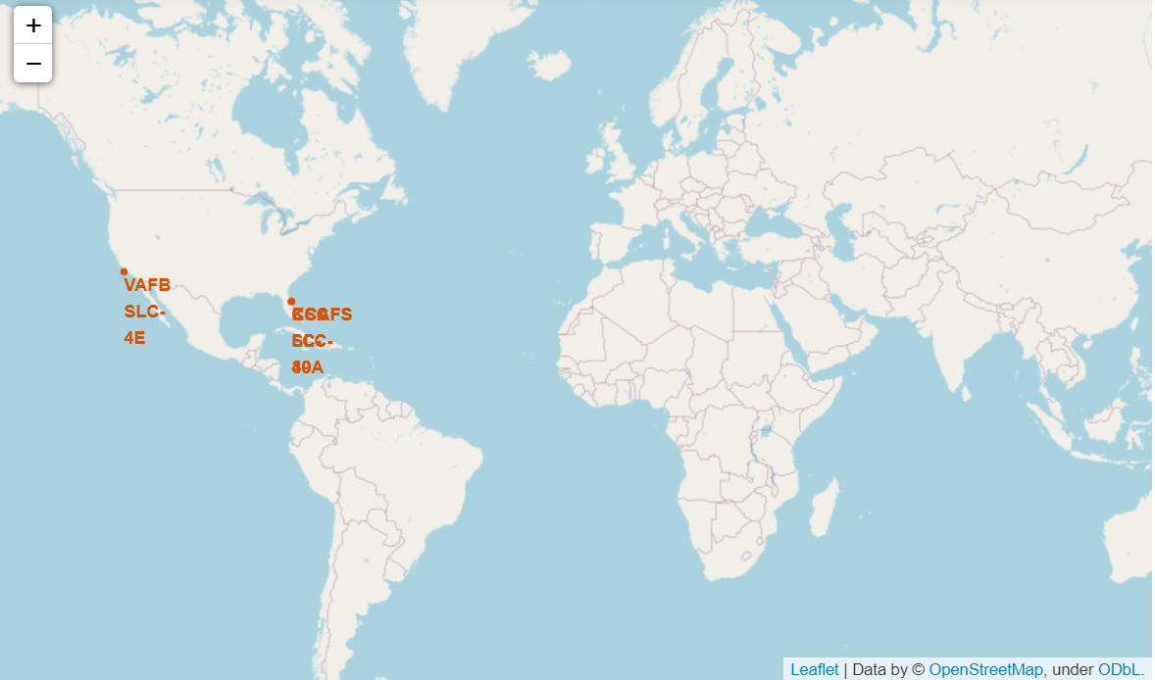
SpaceX launch Sites
We can see that the SpaceX launch sites are in the west and east coasts of the United States of America.

Slide 36
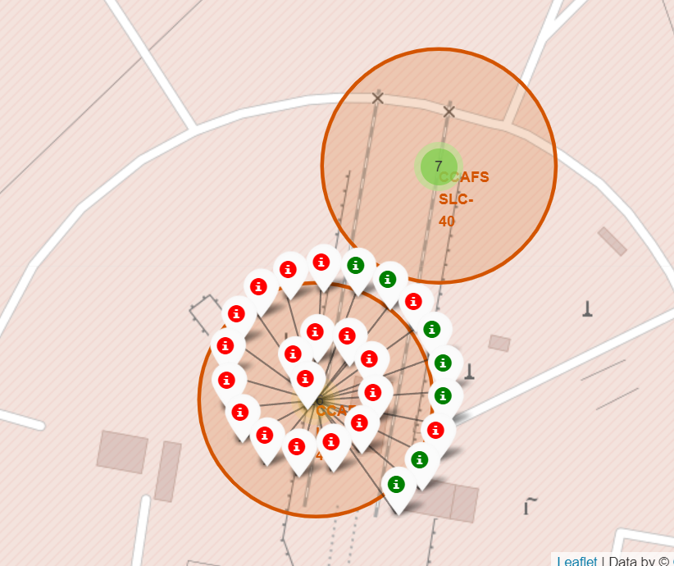
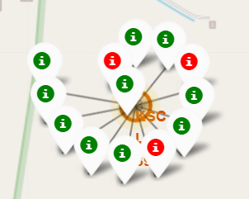
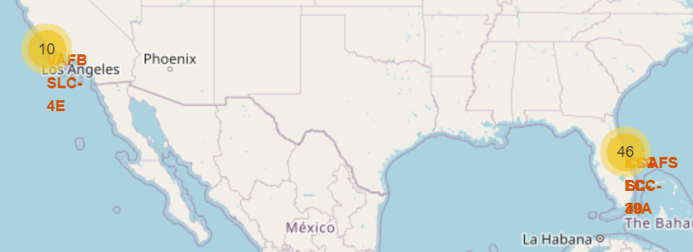
Colour Labelled Markers
Examples of the Florida launch sites with succesful launches (green) and failures (red).

Slide 37
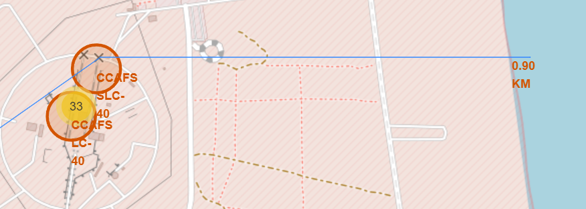
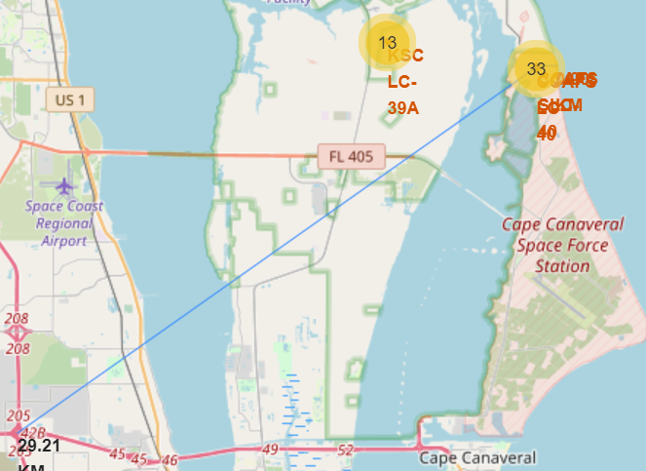
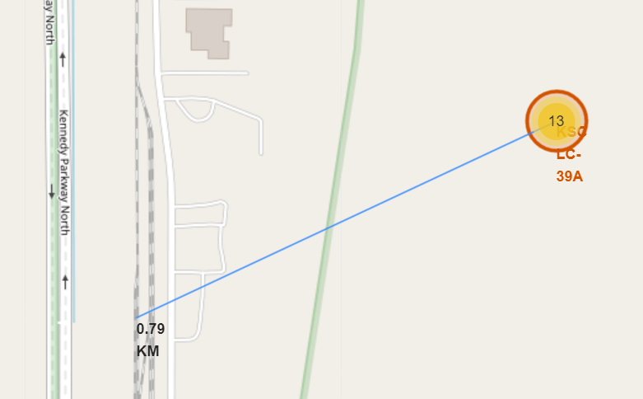
Distance to Specific Objects
Questions:
•Are launch sites in close proximity to railways?
→ No
•Are launch sites in close proximity to highways?
→ No
•Are launch sites in close proximity to coastline?
→ Yes
•Do launch sites keep certain distance away from cities?
→ Yes
Distance launch site to the coastline.
Distance launch site to the next big city (Florida, 29.21km).
Distance launch site to the next railways.

Slide 38

Section 4

Slide 39
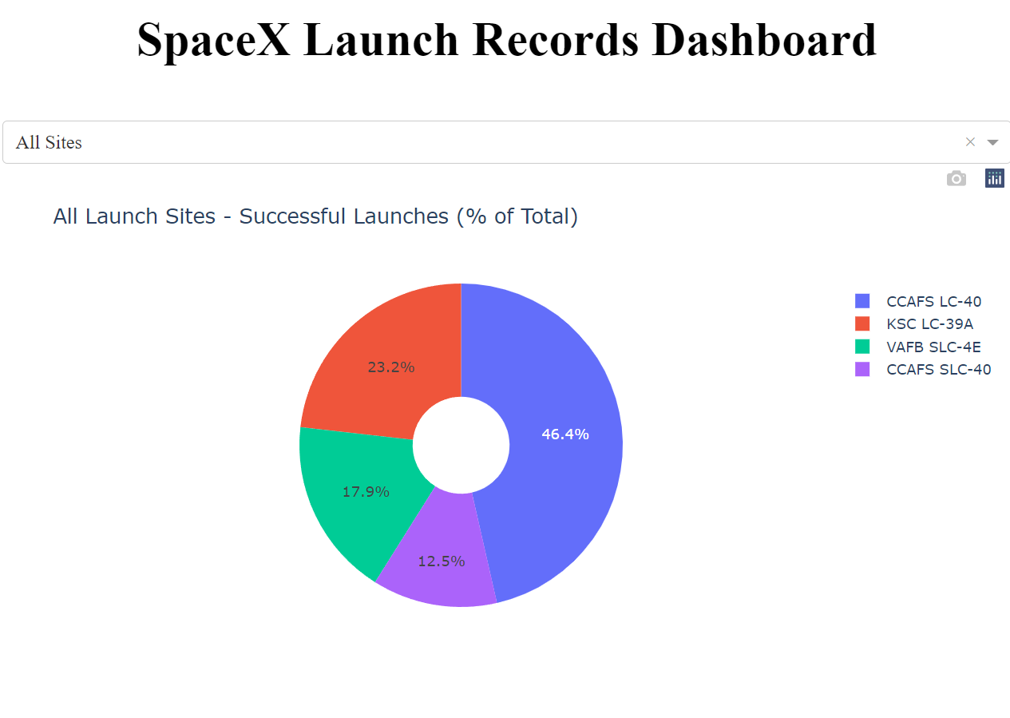
Successful Launches (% of Total)
The biggest share of the successful launches came from launch site: CCAFS LC-40

Slide 40
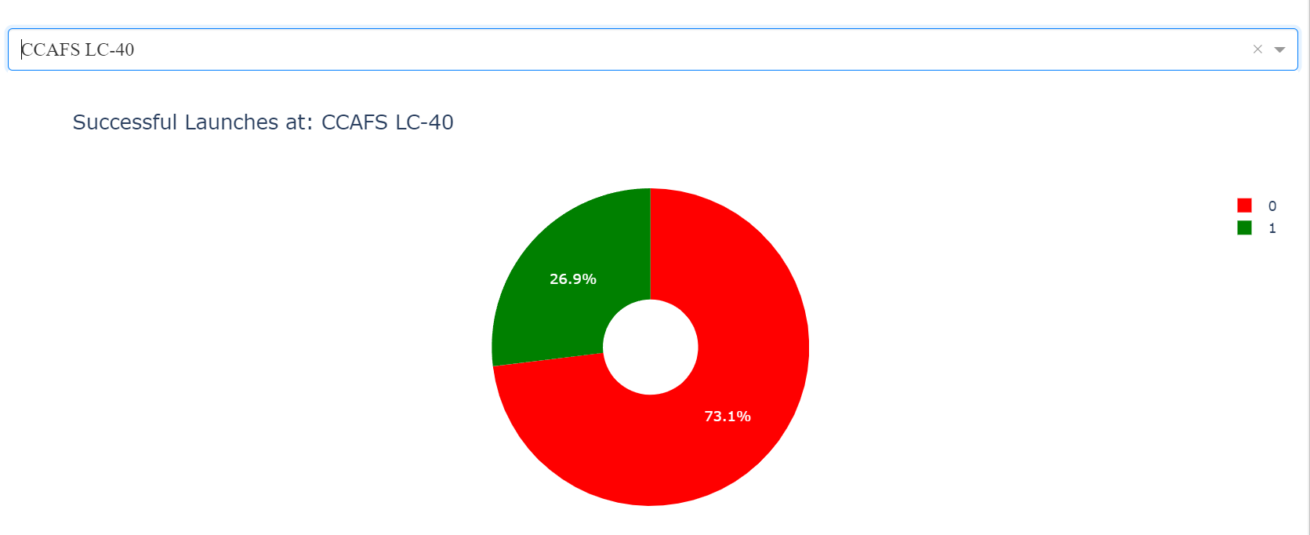
Fraction of Successful Launches
Despite that 73.1% of the launches were failures this launch site contributed to most of the successful launches.

Slide 41
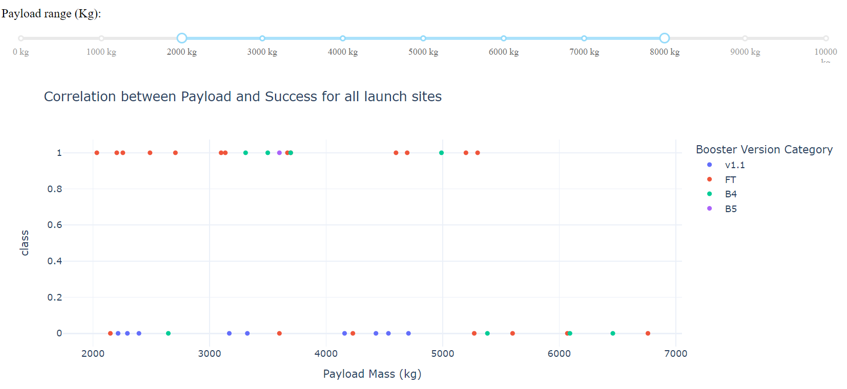
Correlation between Payload and Success
Higher Payload mass leads to failures more often.

Slide 42

Section 5

Slide 43
Classification Accuracy
KNN, LogisticRegression and SVM all have a Score of 83.33%
All of these 3 Models seem to be ok to use.

Slide 44
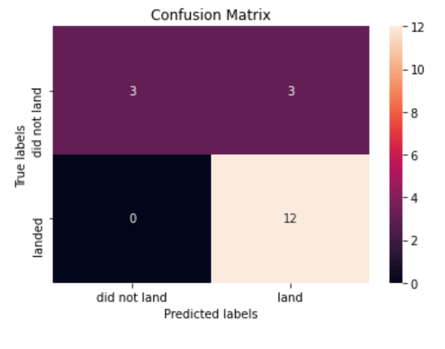
Confusion Matrix
The Confusion Matrix shows the true labels in the rows and what the model predicted (predicted labels) in the columns.
All 12 successful landings were predicted correctly.
The 6 not failed landings were 3 times predicted as successful and 3 times as failures.

Slide 45
Conclusions
What we found:
Higher Payload → lower probability of success.
With more launch experience the success rate is higher.
The biggest share of the successful launches came from launch site: CCAFS LC-40
The orbits ES-L1, GEO, HEO and SSO have perfect success rates.

Slide 46



Appendix
The calculation and visualization of the results was done with python using Jupyter Notebooks and PyCharm.

Slide 47


